Slide 1
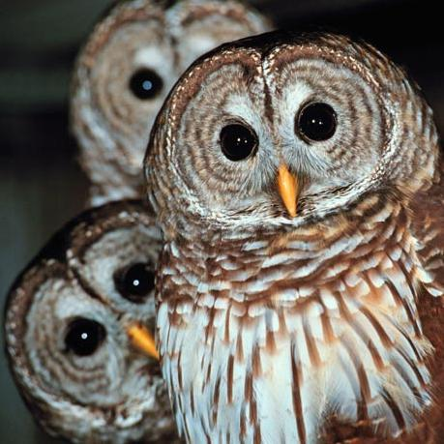
Outing For Owls
A Fourth Grade Science WebQuest
Created by:
Miss Mysliwy

Slide 2
Introduction
You have just been chosen to be Miss Mysliwy’s owl expert for the class.
Her computer isn’t working, and she needs your help to research information about owls.
She is counting on you to find out information about owls and be able to share with the rest of the class.
Are you willing to accept the challenge?

Slide 3
Task
Use the internet to find out the following information:
What are the main body parts of an owl?
What is a unique body part that owl has?
What type of habitat does an owl live in?
What kind of food does an owl eat?
How does an owl get its food?
What time of day are the owls active?
What are five different kinds of owl species?

Slide 4
Task Continued
After you find this information, you and your partner need to create a PowerPoint of your own.
Whoooooooo needs you? Miss Mysliwy! So get your computer and start owling!

Slide 5
Resources
Use these sites to help you and your partner on your owl hunt.
http://www.owlpages.com/links.php?cat=Owls-Children
http://idahoptv.org/dialogue4kids/season9/owl/facts.cfm
http://animals.about.com/od/owls/a/owl-facts.htm
http://www.birdsforever.com/owl.html
http://www.hometrainingtools.com/learn-about-owls/a/1573/

Slide 6
Process
One partner will go to the laptop cart and get a laptop. Log in.
The other partner needs to get the notes form from Miss Mysliwy. Owl Notes
Use the given websites to complete all questions.
When finished researching open a blank Microsoft PowerPoint
Make the first slide your title page. (Don’t forget to include “Owls” in your title, and put your names at the bottom)
Make 1 slide for each of the 7 questions.
Add images from any of the websites to your page.
Remember you kids like graphics, so change the background add effects etc.
Save your project .
Wait to present! ☺

Slide 7
Evaluation
Your project will be evaluated out of 75 points:
35 points for answering the questions correctly on the handout form the WebQuest. (5 points for each question)
15 points for completing and following directions of the PowerPoint part of the project.
10 points for creativity and images in the PowerPoint.
10 points for presenting with your partner.
5 points for using correct spelling and grammar.

Slide 8
Conclusion
Students who have successfully completed Miss Mysliwy’s Owl WebQuest have learned and have been evaluated on the following Indiana State Standards:
4.3 Science
Observe, describe and ask questions about structures of organisms and how they affect their growth and survival
4.7.2 Language Arts
Summarize major ideas and supporting evidence presented in spoken presentations
4.4.9 Language Arts
Use a computer to draft, revise, and publish writing, demonstrating basic keyboarding skills and familiarity with common computer terminology.
4.7.5 Language Arts
Organization and Delivery of Oral Communication: Present effective introductions and conclusions that guide and inform the listener's understanding of important ideas and details
4.5.6 Language Arts
Write for different purposes (information, persuasion, description) and to a specific audience or person.(Core Standard)

